Slide 1
Financial Accounting
IFRS 5th Edition
Weygandt ● Kimmel
Chapter 4
Completing the Accounting Cycle
This slide deck contains animations. Please disable animations if they cause issues with your device.
Copyright © John Wiley & Sons, Inc.

Slide 2
Chapter Outline
Learning Objectives
LO 1 Prepare a worksheet (skip, if interested, in appendix).
LO 2 Prepare closing entries and a post-closing trial balance.
LO 3 Explain the steps in the accounting cycle and how to prepare correcting entries.
LO 4 Identify the sections of a classified statement of financial position.

Slide 3
Learning Objective 2 Prepare Closing Entries and a Post-Closing Trial Balance.
L O 2

Slide 4
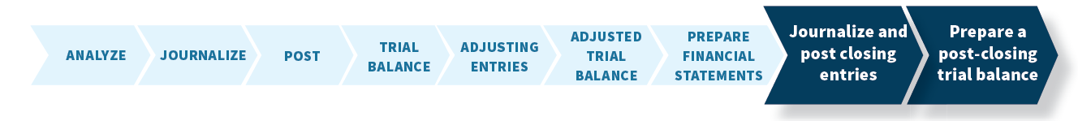
Closing the Books
At the end of the accounting period, the company makes the accounts ready for the next period.
L O 2

Slide 5
Bridge between B/S and I/S
Statement of retained earnings
End RE = Beg RE + NI – Dividends
NI = Revenue – Expense
[Income Stmt]
Asset = Liabilities + Cont. Capital + RE
[Balance Sheet]

Slide 6
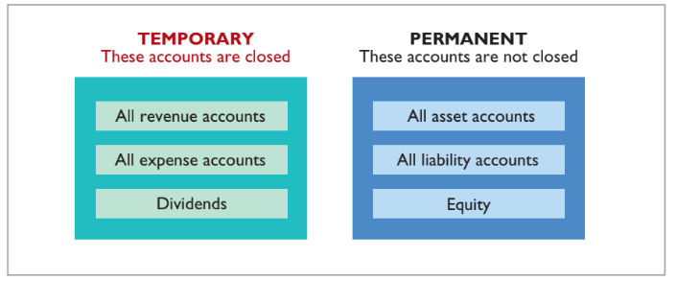
Temporary versus Permanent Accounts
Illustration 4.8: Temporary versus permanent accounts
L O 2
Notes:
Temporary accounts: relate only to a given accounting period. (Rev, Exp, Divs → I/S)
Permanent accounts: relate to one or more future accounting periods. Company carries forward the balance of permanent accounts. (Asset, Liab, OE → B/S)

Slide 7
Preparing Closing Entries
Closing entries formally recognize in the ledger the transfer of:
Net income (or net loss) and Dividends to retained earnings
Produce a zero balance in each temporary account.
Companies generally journalize and post closing entries only at the end of the annual accounting period.
L O 2

Slide 8
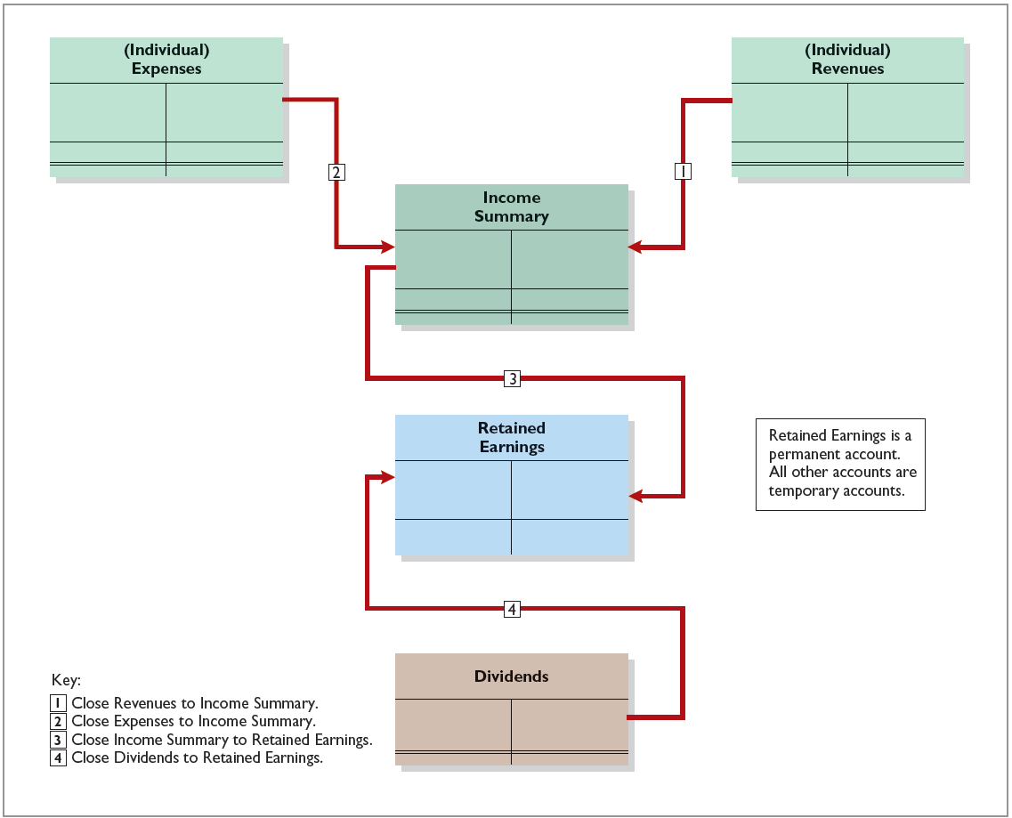
Preparing Closing Entries Diagram
Illustration 4.9: Diagram of closing process
L O 2
Notes:
Follow steps. Revenues and expenses to income summary. Then compute net income, transfer to retained earnings account & takeaway dividends.
Income summary → only show up in closing account. Temporary account created during closing.

Slide 9
Example
Assume company has following:
Revenue = 500
Expense = 300
Beginning Balance of RE = 400
Dividend = 100
Lets do example of closing entries

Slide 10
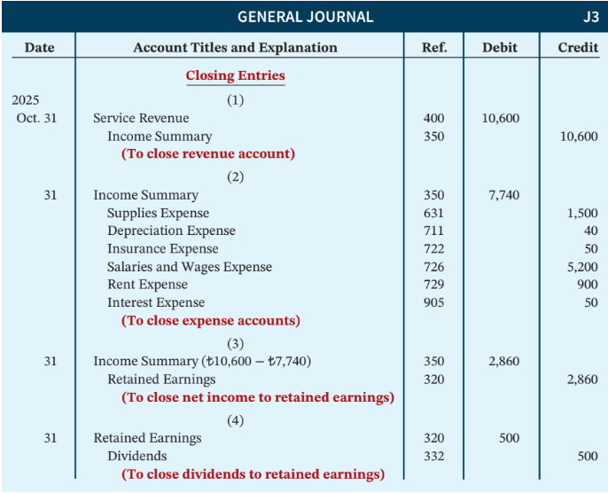
Closing Entries Illustrated
Illustration 4.10: Closing entries journalized
L O 2
Notes:
Revenue has credit account. To CLOSE the revenue account, we debit service revenue and credit income summary.
Expense has debit account. To CLOSE the expense account, we credit the expenses and debit income summary.

Slide 11
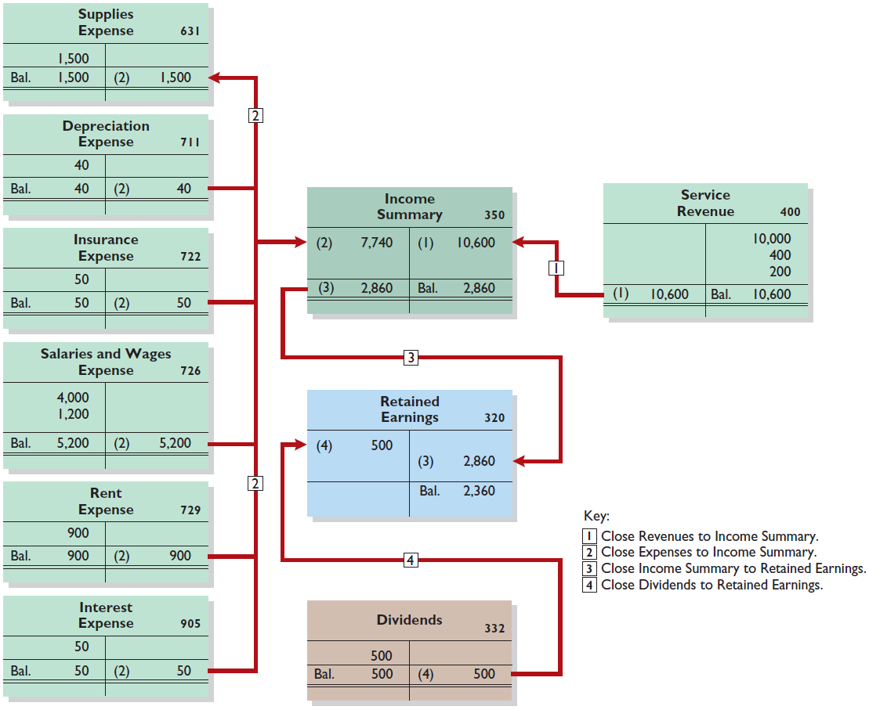
Posting Closing Entries
Illustration 4.11: Posting of closing entries
L O 2

Slide 12
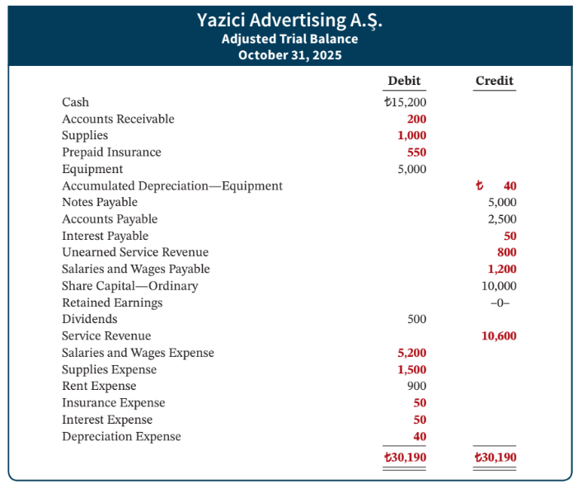
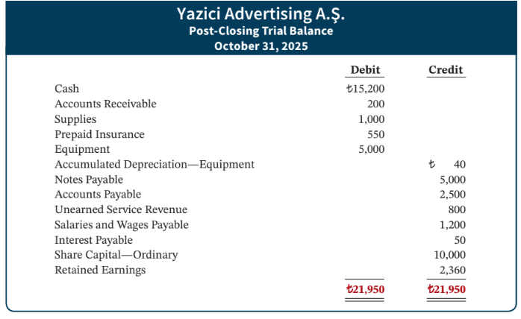
Illustration 4.12
Illustration 4.12: Post-closing trial balance
L O 2
Notes:
After journalizing and posting closing entries, firm prepare post-closing trial balance.
Use to prove equality of permanent account balances carried forward into next acct period.
Since temporary accounts will be zero, post-closing trial balance only carries permanent accounts.

Slide 13
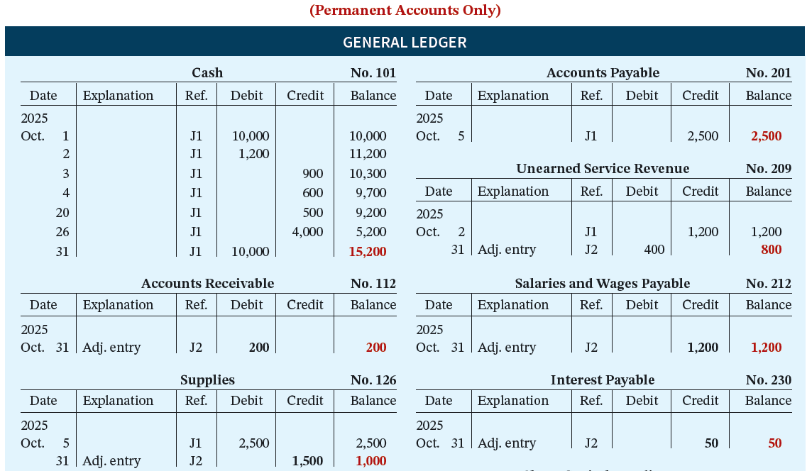
Illustration 4.13 (Partial)
Illustration 4.13 (Partial): General ledger, permanent accounts
L O 2

Slide 14
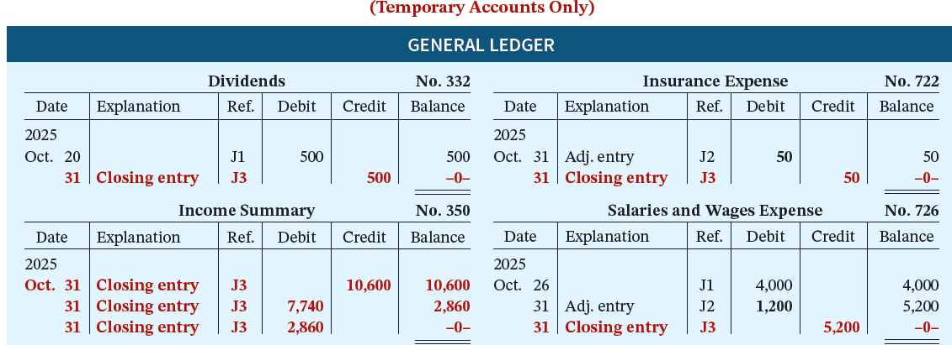
Illustration 4.14 (Partial)
Illustration 4.14 (Partial): General ledger, temporary accounts
L O 2

Slide 15









DO IT! 2: Closing Entries
Hancock Company has the following balances in selected accounts of its adjusted trial balance.
Accounts Payable €27,000 Dividends €15,000
Service Revenue 98,000 Share Capital—Ordinary 42,000
Rent Expense 22,000 Accounts Receivable 38,000
Salaries and Wages Supplies Expense 7,000
Expense 51,000
Prepare the closing entries at December 31.
L O 2

Slide 16
DO IT! 2: Closing Entries - Solution (1 of 2)
Prepare the closing entries at December 31.
Service Revenue 98,000
Income Summary 98,000
Income Summary 80,000
Salaries and Wages Expense 51,000
Rent Expense 22,000
Supplies Expense 7,000
L O 2

Slide 17
DO IT! 2: Closing Entries - Solution (2 of 2)
Income Summary 18,000
Retained Earnings 18,000
Retained Earnings 15,000
Dividends 15,000
L O 2

Slide 18
Posting Closing Entries
Illustration 4.11: Posting of closing entries
L O 2

Slide 19
Learning Objective 3 Explain the Steps in the Accounting Cycle and How to Prepare Correcting Entries.
L O 3

Slide 20
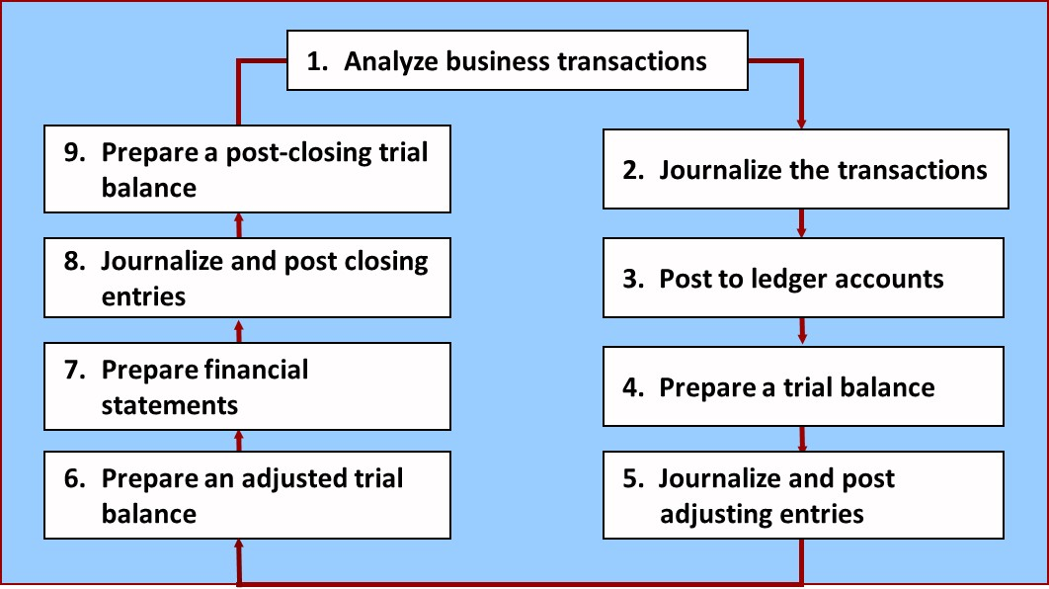
The Accounting Cycle
Illustration 4.15: Required steps in the accounting cycle
L O 3
Notes:
Covered whole acct cycle.

Slide 21
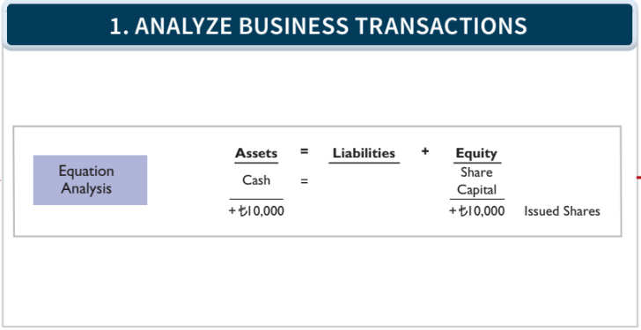
1. Analyze Business Transactions
Illustration 4.15: Required steps in the accounting cycle (continued)
L O 3

Slide 22
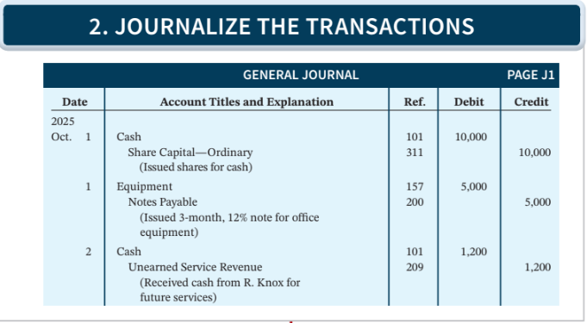
2. Journalize the Transactions
Illustration 4.15: Required steps in the accounting cycle (continued)
L O 3

Slide 23
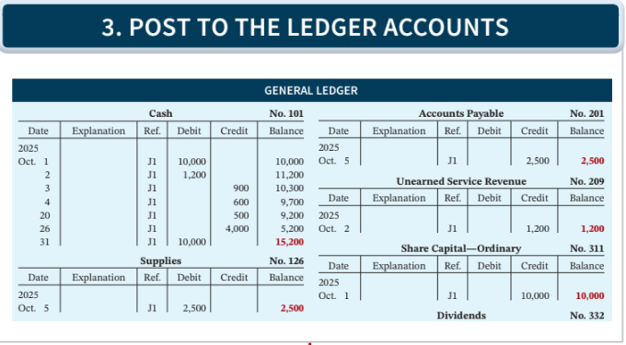
3. Post to the Ledger Accounts
Illustration 4.15: Required steps in the accounting cycle (continued)
L O 3

Slide 24
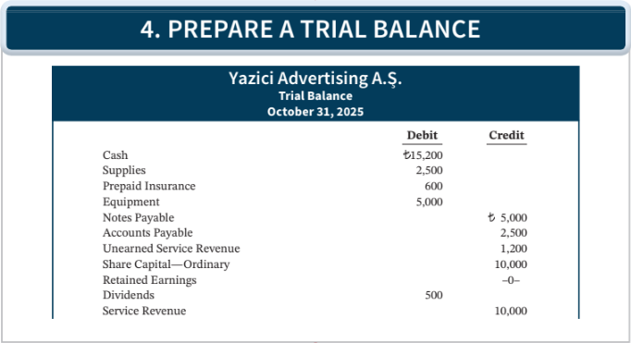
4. Prepare a Trial Balance
Illustration 4.15: Required steps in the accounting cycle (continued)
L O 3

Slide 25
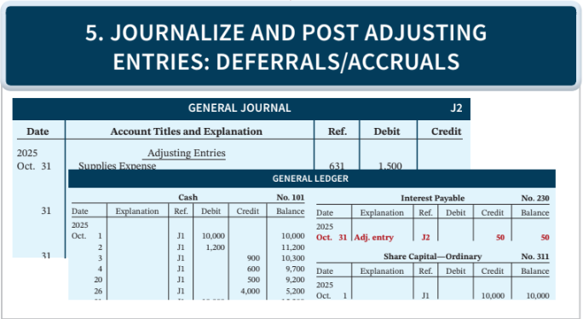
5. Journalize and Post AJEs
Illustration 4.15: Required steps in the accounting cycle (continued)
L O 3

Slide 26
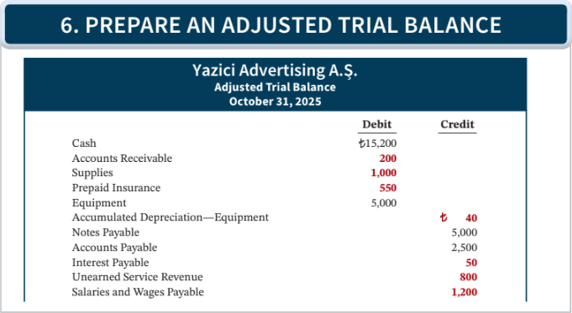
6. Prepare an Adjusted Trial Balance
Illustration 4.15: Required steps in the accounting cycle (continued)
L O 3

Slide 27
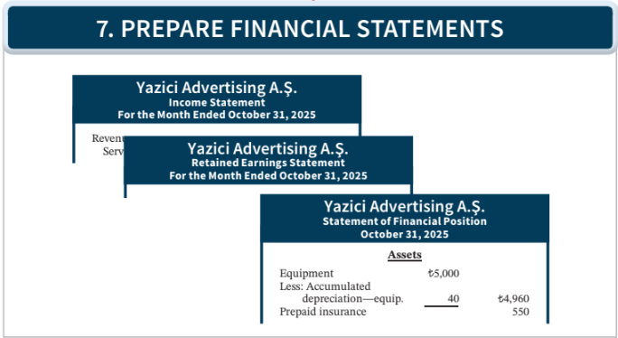
7. Prepare Financial Statements
Illustration 4.15: Required steps in the accounting cycle (continued)
L O 3

Slide 28
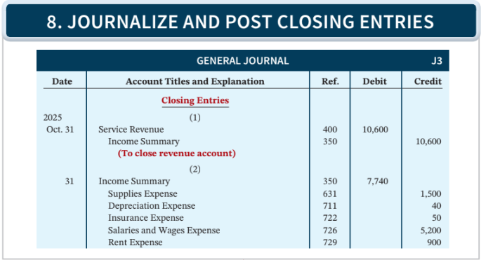
8. Journalize and Post Closing Entries
Illustration 4.15: Required steps in the accounting cycle (continued)
L O 3

Slide 29
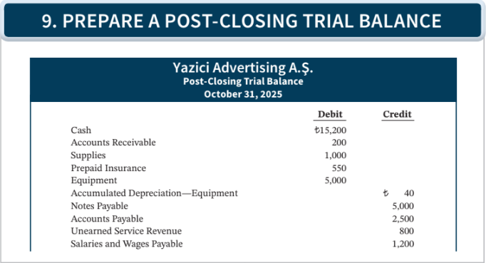
9. Prepare a Post-Closing Trial Balance
Illustration 4.15 (Partial): Required steps in the accounting cycle (continued)
L O 3

Slide 30
Correcting Entries—Avoidable Step
Unnecessary if accounting records are free of errors
Made whenever an error is discovered
Must be posted before closing entries
Instead of preparing a correcting entry, it is possible to reverse the incorrect entry and then prepare the correct entry.
L O 3

Slide 31
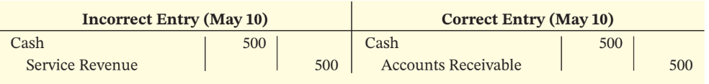
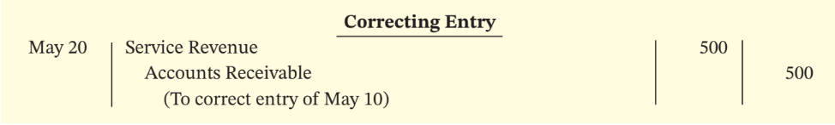
Correcting Entries—Case 1
Case 1: On May 10, Mercato Co. journalized and posted a NT$500 cash collection on account from a customer as a debit to Cash and a credit to Service Revenue for NT$500. The error was discovered when the customer paid the remaining balance in full.
Illustration 4.16-17: Comparison of entries (16) and Correcting entry (17)
L O 3
Notes:
Do reversing entry. Then do correction.

Slide 32
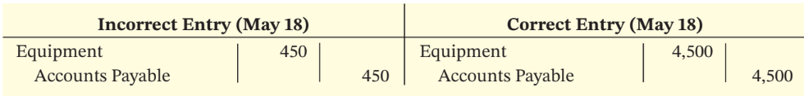
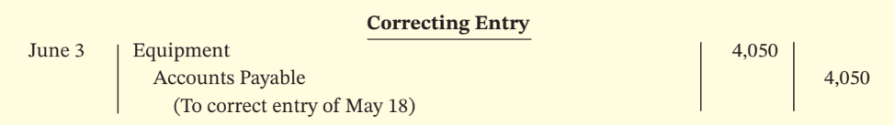
Correcting Entries—Case 2
Case 2: On May 10, 18, Mercato purchased on account equipment costing NT$4,500. The transaction was journalized and posted as a debit to Equipment NT$450 and a credit to Accounts Payable NT$450. The error was discovered on June 3.
Illustration 4.18-19: Comparison of entries (18) and Correcting entry (19)
L O 3

Slide 33
DO IT! 3: Correcting Entries
Sanchez Company discovered the following errors made in January 2025 (amounts in thousands).
A payment of Salaries and Wages Expense of $600 was debited to Supplies and credited to Cash, both for $600.
A collection of $3,000 from a client on account was debited to Cash $200 and credited to Service Revenue $200.
The purchase of supplies on account for $860 was debited to Supplies $680 and credited to Accounts Payable $680.
Correct the errors without reversing the incorrect entry.
L O 3

Slide 34
DO IT! 3: Correcting Entries - Solution
1. Salaries and Wages Expense 600
Supplies 600
2. Service Revenue 200
Cash 2,800
Accounts Receivable 3,000
3. Supplies ($860 - $680) 180
Accounts Payable 180
L O 3

Slide 35
Learning Objective 4 Identify the Sections of a Classified Statement of Financial Position.
L O 4

Slide 36
Classified Statement of Financial Position
Presents a snapshot at a point in time
To improve users’ understanding, companies group together similar assets and similar liabilities
Assets | Equity and Liabilities
Intangible assets Property, pant, and equipment Long-term investments Current assets | Equity Non-current liabilities Current liabilities
Illustration 4.20: Standard statement of financial position classifications
L O 4
Notes:
We want to be able to look at the balance sheet and figure out information efficiency. For example, split long-term assets (less liquid, i.e., more illiquid) and current assets (more liquid). Also want to split liabilities that are due soon (current liabilities) and due more in the future (non-current liab).

Slide 37
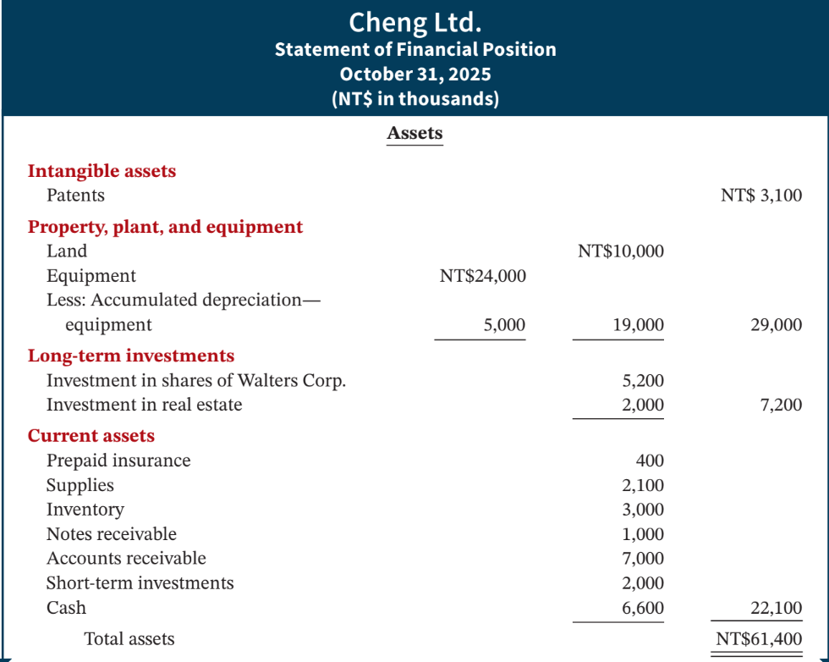
Illustration 4.21
Illustration 4.21: Classified statement of financial position
L O 4
Notes:
Intangible assets → long lived assets that do not have physical substance
PPE → long term assets. Equipment requires depreciation
Long-term investments → investments in stocks / bonds of other companies; investments in long term assets such as land or bldg. that are not currently being used in operating activities;

Slide 38
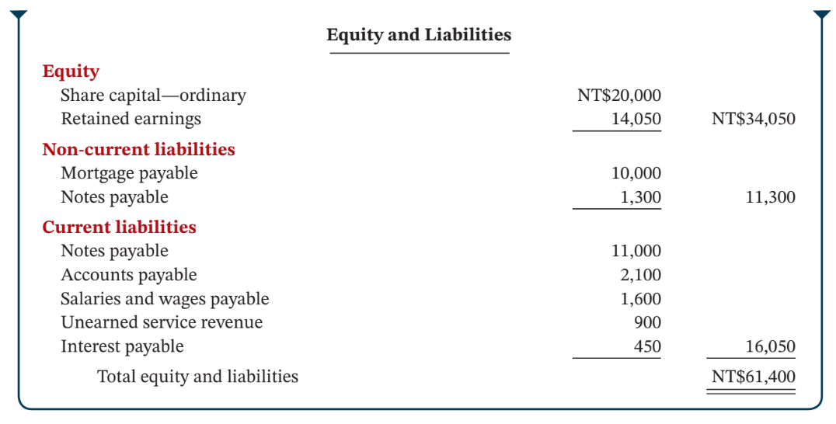
Illustration 4.21 (continued)
Illustration 4.21: Classified statement of financial position (Continued)
L O 4
Notes:
Non-Current liabilities → due after 1 year
Current liabilities → due within 1 year

Slide 39
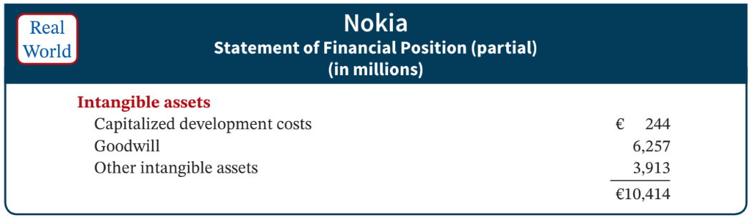
Intangible Assets
Long-lived assets that do not have physical substance.
Illustration 4.22: Intangible assets section
L O 4

Slide 40
Property, Plant, and Equipment
Long useful lives
Currently used in operations
Depreciation - allocating the cost of assets to a number of years
Accumulated depreciation - total amount of depreciation expensed thus far in the asset’s life
Sometimes called fixed assets or plant assets
L O 4

Slide 41
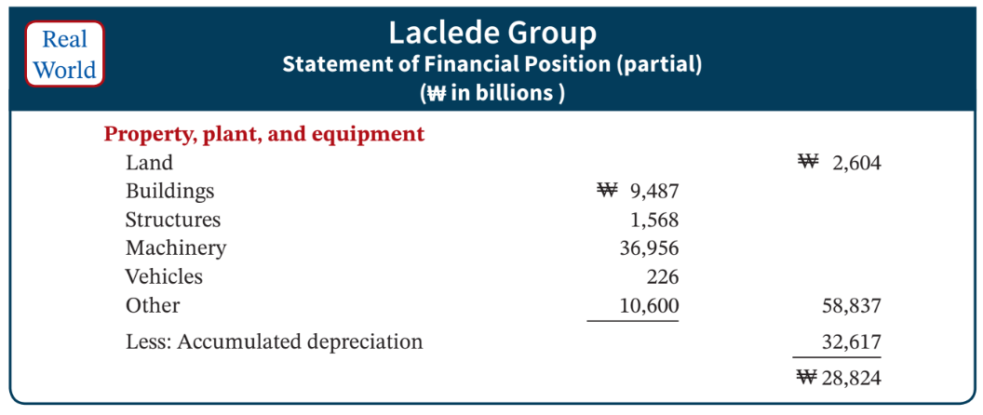
Property, Plant, and Equipment Section
Illustration 4.23: Property, plant, and equipment section
L O 4

Slide 42
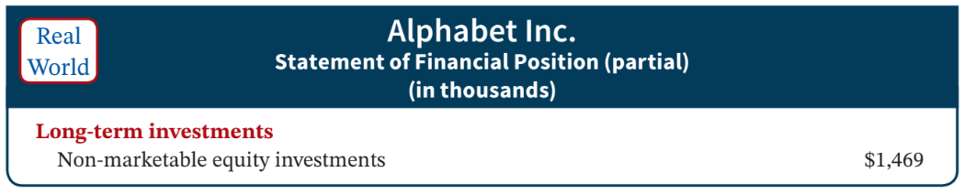
Long-Term Investments
Investments in stocks and bonds of other companies that are normally held for many years
Investments in long-term assets such as land or buildings that are not currently being used in operating activities
Long-term notes receivable
Illustration 4.24: Long-term investments section
L O 4

Slide 43
Current Assets
Assets that a company expects to convert to cash or use up within one year or the operating cycle, whichever is longer
Operating cycle is the average time that it takes to
purchase inventory,
sell it on account, and
collect cash from customers
L O 4

Slide 44
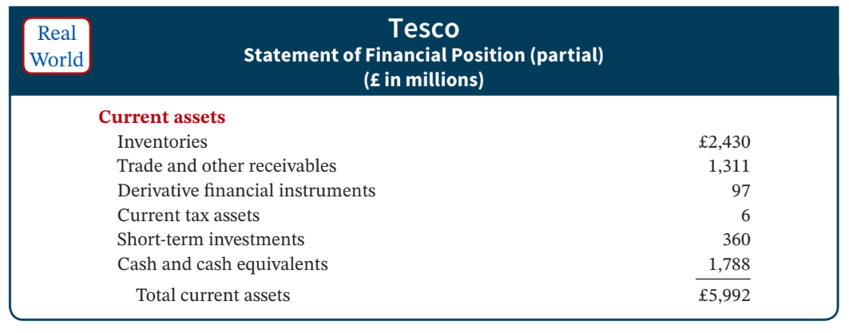
Current Assets Presentation
Illustration 4.25: Current assets section
L O 4

Slide 45
Classified Statement of Financial Position Review Question
Current assets are listed:
in the reverse order of expected conversion to cash.
by importance.
by longevity.
by size.
L O 4

Slide 46
Classified Statement of Financial Position – Solution
Current assets are listed:
in the reverse order of expected conversion to cash. (Correct)
by importance.
by longevity.
by size.
L O 4

Slide 47
Current Assets Review Question
The correct order of presentation in a classified statement of financial position for the following current assets is:
accounts receivable, cash, prepaid insurance, inventory.
prepaid insurance, inventory, accounts receivable, cash.
cash, accounts receivable, inventory, prepaid insurance.
inventory, cash, accounts receivable, prepaid insurance.
L O 4

Slide 48
Current Assets – Solution
The correct order of presentation in a classified statement of financial position for the following current assets is:
accounts receivable, cash, prepaid insurance, inventory.
prepaid insurance, inventory, accounts receivable, cash. (Correct)
cash, accounts receivable, inventory, prepaid insurance.
inventory, cash, accounts receivable, prepaid insurance.
L O 4

Slide 49
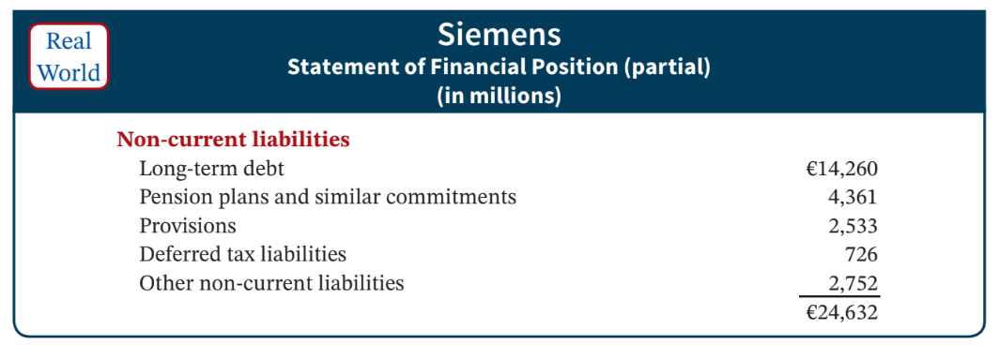
Non-Current Liabilities
Obligations a company expects to pay after one year.
Illustration 4.27: Non-current liabilities section
L O 4

Slide 50
Current Liabilities
Obligations company has to pay within coming year or its operating cycle, whichever is longer
Common examples are accounts payable, salaries and wages payable, notes payable, interest payable, income taxes payable, and current maturities of long-term obligations
Liquidity - ability to pay obligations expected to be due within the next year
L O 4

Slide 51
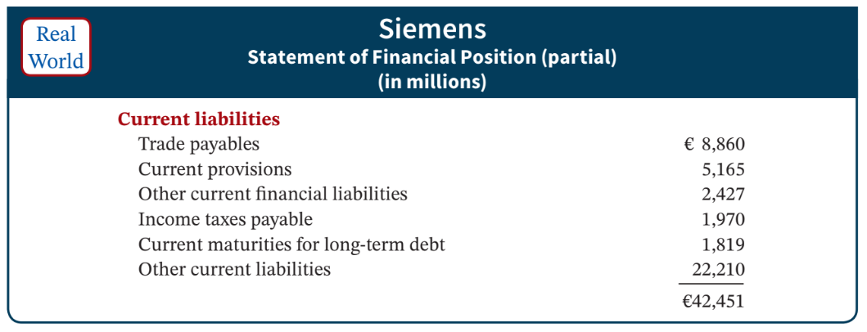
Current Liabilities – Presentation
Illustration 4.28: Current liabilities section
L O 4

Slide 52
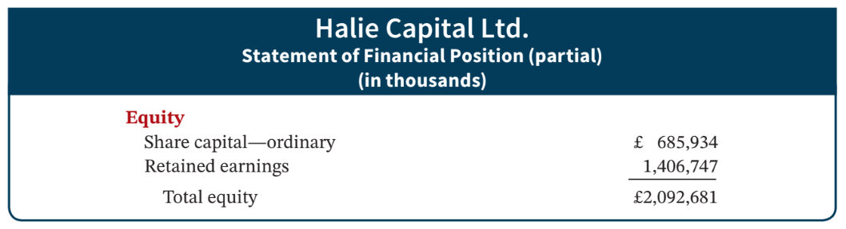
Equity
Proprietorship - one capital account
Partnership - capital account for each partner
Corporation’s equity consists of two accounts – Share Capital-Ordinary and Retained Earnings
Illustration 4.26: Equity section
L O 4

Slide 53
DO IT! 4: Statement of Financial Position Classifications
Match each of the following to its proper statement of financial position classification, shown below. If the item would not appear on a statement of financial position, use “NA.”
CL | Salaries and wages payable |  | LTI | Stock investments (long-term)
NA | Service revenue |  | PPE | Equipment
CL | Interest payable |  | PPE | Accumulated depreciation
IA | Goodwill |  | NA | Depreciation expense
CA | Debt investments (short-term) |  | E | Share capital—ordinary
NCL | Mortgage payable (due in 3 years) |  | CL | Unearned service revenue
Intangible assets (IA) |  | Equity (E)
Property, plant, and equipment (PPE) |  | Non-current liabilities (NCL)
Long-term investments (LTI) |  | Current liabilities (CL)
Current assets (CA)
L O 4

Slide 54
DO IT! 4: Statement of Financial Position Classifications - Solution
__CL__ | Salaries and wages payable | __LTI__ | share investments (long-term)
__NA__ | Service revenue | __PPE__ | Equipment
__CL__ | Interest payable | __PPE__ | Accumulated depreciation—equipment
__IA__ | Goodwill | __NA__ | Depreciation expense
__CA__ | Debt investments (short-term) | __E__ | Share capital—ordinary
__NCL__ | Mortgage payable (due in 3 years) | __CL__ | Unearned service revenue
Related exercise material: BE4.10, BE4.11, DO IT!4.4, E4.3, E4.9, E4.14, E4.15, E4.16, and E4.17.
L O 4

Slide 55
Learning Objective 6 Compare the Procedures for the Accounting Cycle Under I F R S and U.S. G A A P.
L O 6

Slide 56
G A A P and I F R S – Similarities
Key Points
In general, G A A P follows the similar guidelines as this text for presenting items in the current asset section, except that under G A A P items are listed in order of liquidity, while under I F R S they are often listed in reverse order of liquidity. For example, under G A A P cash is listed first, but under I F R S it is listed last.
Both G A A P and I F R S are increasing the use of fair value to report assets. However, at this point I F R S has adopted it more broadly. As examples, under I F R S companies can apply fair value to property, plant, and equipment; natural resources; and in some cases intangible assets.
L O 6

Slide 57
G A A P and I F R S – Further Similarities
Both I F R S and G A A P require disclosures about (1) accounting policies followed, (2) judgments that management has made in the process of applying the entity’s accounting policies, and (3) the key assumptions and estimation uncertainty that could result in a material adjustment to the carrying amounts of assets and liabilities within the next financial year.
Comparative prior-period information must be presented and financial statements must be prepared annually.
L O 6

Slide 58
G A A P and I F R S – Differences
I F R S requires that specific items be reported on the statement of financial position, whereas no such general standard exists in G A A P. However, under G A A P, public companies must follow U.S. Securities and Exchange Commission (SEC) regulations, which require specific line items as well. In addition, specific G A A P standards mandate certain forms of reporting statement of financial position information. The S E C guidelines are more detailed than I F R S .
I F R S requires that a complete set of financial statements must include comparative information from the preceding period. There is no similar requirement in G A A P. However, public companies following U.S. S E C regulations have a similar requirement.
L O 6

Slide 59
G A A P and I F R S – Further Differences
While IFRS companies often report non-current assets before current assets in their statements of financial position, this is never seen under G A A P. Also, some I F R S companies report the subtotal “net assets,” which equals total assets minus total liabilities. This practice is also not seen under G A A P.
A key difference in valuation is that under I F R S companies, under certain conditions, can report property, plant, and equipment at cost or at fair value, whereas under G A A P this practice is not allowed.
I F R S requires that a company must make an explicit and unreserved statement that the financial statements comply with I F R S standards. No similar statement is required under US G A A P.
L O 6

Slide 60
Differences in Terminology
G A A P has many differences in terminology from what are shown in your textbook. For example, in the investment category, shares are called stock. Also note that Share Capital—Ordinary is referred to as Common Stock. In addition, the format used for statement of financial position presentation is often different between G A A P and I F R S.
I F R S officially uses the term statement of financial position in its literature, while in the United States it is often referred to as the balance sheet.
L O 6

Slide 61
Appendix: (Only read when you have additional time) Learning Objective 1 Prepare a Worksheet (Essentially it is what we covered in chapter 2 and 3, putting them in an excel)
L O 1

Slide 62
The Worksheet
Multiple-column form used in preparing financial statements
Not a permanent accounting record
May be a computerized worksheet
Prepared using a five-step process
Use of worksheet is optional
L O 1

Slide 63
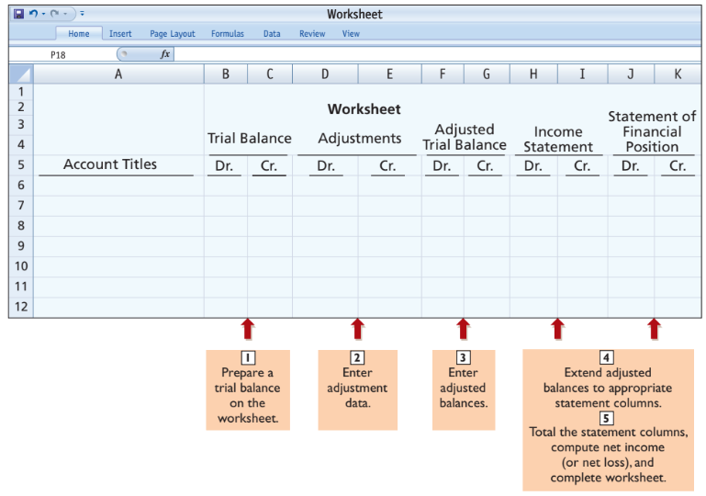
Worksheet
Illustration 4.1: Form and Procedure for a worksheet
L O 1

Slide 64
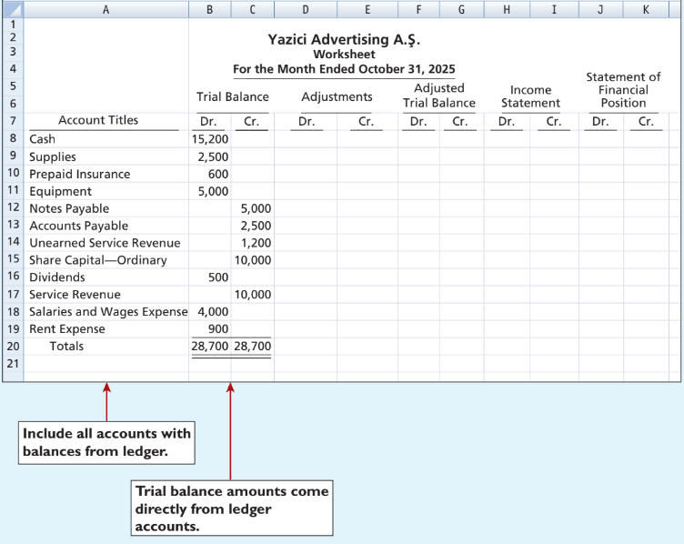
Worksheet: Step 1
Illustration 4.2: Preparing a trial balance
L O 1

Slide 65
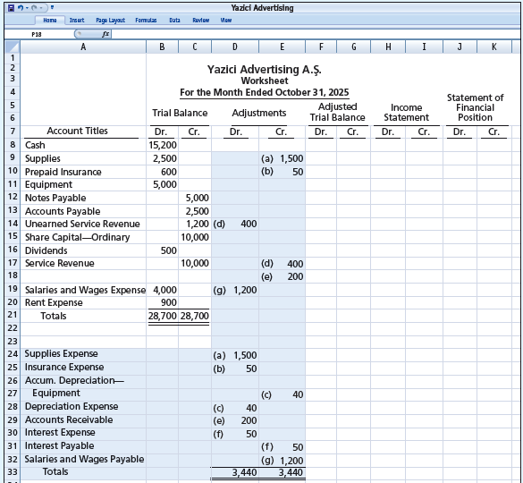
Step 2
Enter all adjustments in the adjustments columns.
If additional accounts are needed, insert them on the lines immediately below the trial balance totals.
Use letters to cross-reference the debit and credit adjustments.
Total adjustments columns and check for equality.
Illustration 4.3: Entering the adjustments in the adjustments columns
L O 1

Slide 66
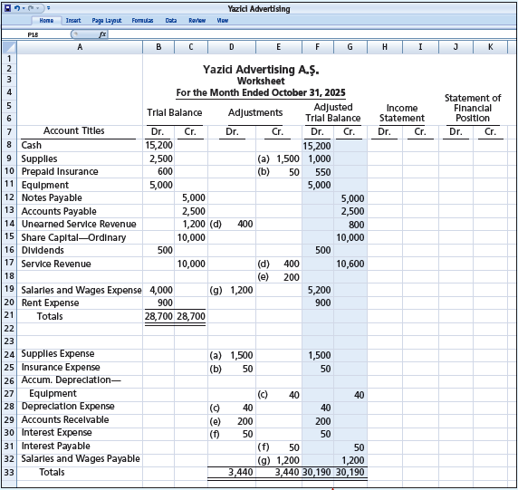
Step 3
Combine trial balance amounts with adjustment amounts to obtain the adjusted trial balance.
Total adjusted trial balance columns and check for equality.
Illustration 4.4: Entering adjusted balances in the adjusted trial balance columns
L O 1

Slide 67
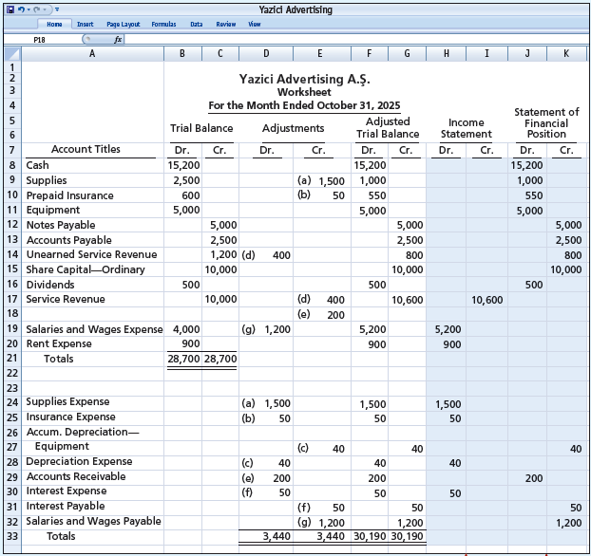
Step 4
Extend all revenue and expense account balances to the income statement columns.
Extend all asset and liability account balances, Share Capital-Ordinary, Retained Earnings and Dividends to the statement of financial position columns.
Illustration 4.5: Extending the adjusted trial balance amounts to appropriate financial statement columns
L O 1

Slide 68
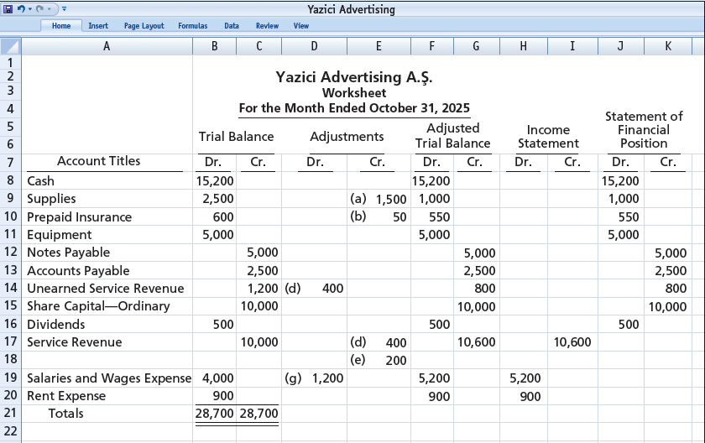
Step 5 – Illustration Part 1
Total each of the financial statement columns. The net income or loss for the period is the difference between the totals of the two income statement columns.
If either the income statement columns or the statement of financial position columns are not equal after the net income or net loss has been entered, there is an error in the worksheet.
Illustration 4.6: Computing net income or net loss and completing the worksheet.
L O 1

Slide 69
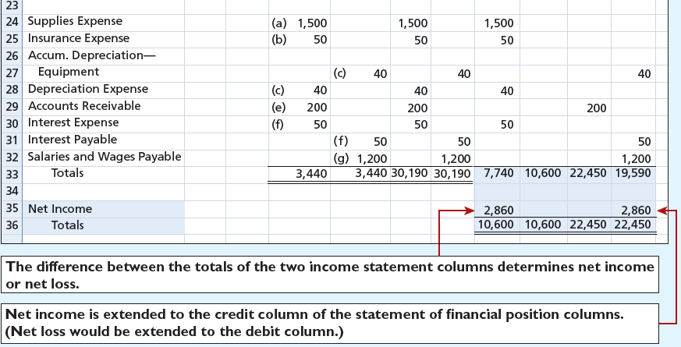
Step 5 – Illustration Part 2
Illustration 4.6: Computing net income or net loss and completing the worksheet.
L O 1

Slide 70
Steps in Preparing a Worksheet Review Question
Which of the following statements is incorrect concerning the worksheet?
The worksheet is essentially a working tool of the accountant.
The worksheet is distributed to management and other interested parties.
The worksheet cannot be used as a basis for posting to ledger accounts.
Financial statements can be prepared directly from the worksheet before journalizing and posting the adjusting entries.
L O 1

Slide 71
Steps in Preparing a Worksheet – Solution
Which of the following statements is incorrect concerning the worksheet?
The worksheet is essentially a working tool of the accountant.
The worksheet is distributed to management and other interested parties. (Correct)
The worksheet cannot be used as a basis for posting to ledger accounts.
Financial statements can be prepared directly from the worksheet before journalizing and posting the adjusting entries.
L O 1

Slide 72
Preparing Financial Statements from a Worksheet
Income statement is prepared from the income statement columns
Statement of financial position and retained earnings statement are prepared from the statement of financial position columns
Companies can prepare financial statements before they journalize and post adjusting entries
L O 1

Slide 73
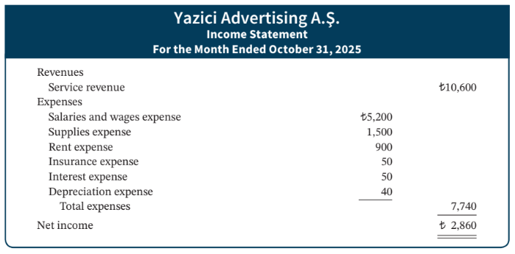
Income Statements from a Worksheet
Illustration 4.7: Financial statements from a worksheet
L O 1

Slide 74
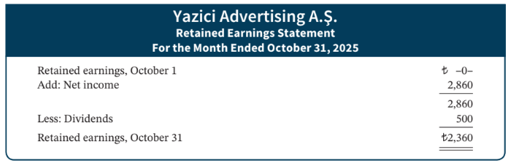
Retained Earnings from a Worksheet
Illustration 4.7: Financial statements from a worksheet (continued)
L O 1

Slide 75
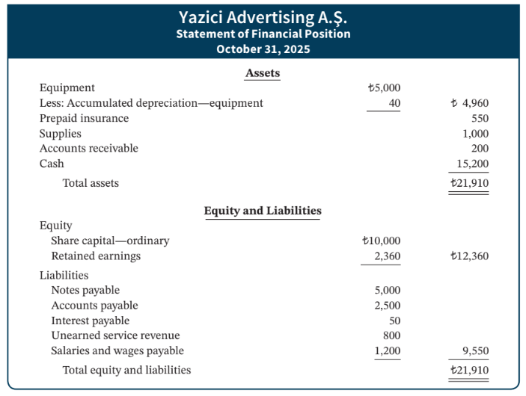
Statement of Financial Position from Worksheet
Illustration 4.7: Financial statements from a worksheet (continued)
L O 1

Slide 76
Preparing Adjusting Entries from a Worksheet
Adjusting entries are prepared from the adjustments columns of worksheet
Journalizing and posting of adjusting entries follows the preparation of financial statements when a worksheet is used
L O 1

Slide 77
DO IT! 1: Worksheet
Susan Elbe is preparing a worksheet. Explain to Susan how she should extend the following adjusted trial balance accounts to the financial statement columns of the worksheet.
Cash
Accumulated Depreciation - Equipment
Accounts Payable
Dividends
Service Revenue
Salaries and Wages Expense
L O 1

Slide 78
DO IT! 1: Worksheet - Solution
Susan Elbe is preparing a worksheet. Explain to Susan how she should extend the following adjusted trial balance accounts to the financial statement columns of the worksheet.
Income statement debit column—Salaries and Wages Expense
Income statement credit column—Service Revenue
Statement of financial position debit column—Cash; Dividends
Statement of financial position credit column—Accumulated Depreciation—Equipment; Accounts Payable
L O 1

Slide 79
Learning Objective 5 Prepare Reversing Entries. (We will not cover in this class, only read when you have additional time)
L O 5

Slide 80
Appendix 4A Reversing Entries
It is often helpful to reverse some adjusting entries before recording regular transactions of the next period
Companies make a reversing entry at the beginning of the next accounting period
Each reversing entry is the exact opposite of the adjusting entry made in the previous period
Use of reversing entries does not change amounts reported in the financial statements
The recording of reversing entries is an optional step
L O 5

Slide 81
Reversing Entries Example
We use the salaries expense transactions for Yazici Advertising as illustrated in Chapters 2, 3, and 4.
October 26 (initial salary entry): Yazici pays ₺4,000 of salaries and wages earned between October 15 and October 26.
October 31 (adjusting entry): Salaries and wages earned between October 29 and October 31 are ₺1,200. The company will pay these in the November 9 payroll.
November 9 (subsequent salary entry): Salaries and wages paid are ₺4,000. Of this amount, ₺1,200 applied to accrued salaries and wages payable and ₺2,800 was earned between November 1 and November 9.
L O 5

Slide 82
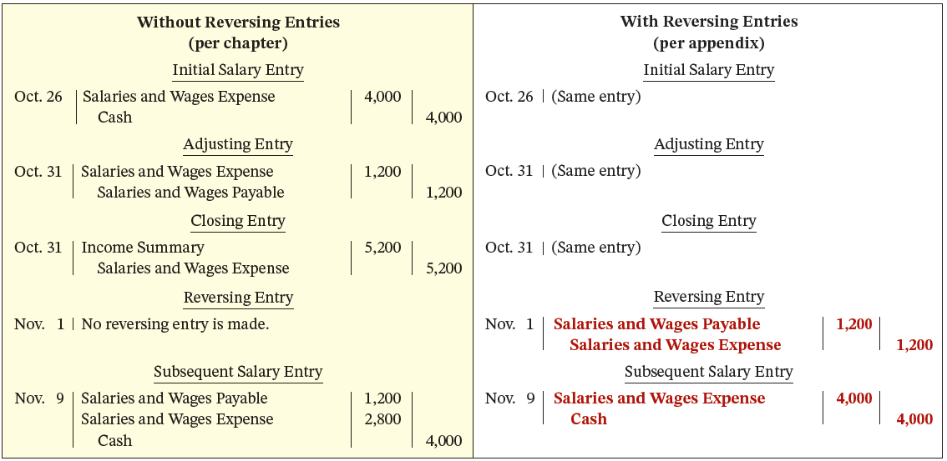
Reversing Entries – Comparative Entries
Illustration 4A.1: Comparative entries-without and with reversing
L O 5

Slide 83
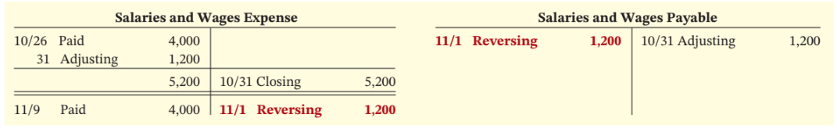
Posting with Reversing Entries
Illustration 4A.2: Postings with reversing entries
L O 5

Slide 84
Copyright
Copyright © John Wiley & Sons, Inc.
All rights reserved. Reproduction or translation of this work beyond that permitted in Section 117 of the 1976 United States Act without the express written permission of the copyright owner is unlawful. Request for further information should be addressed to the Permissions Department, John Wiley & Sons, Inc. The purchaser may make back-up copies for his/her own use only and not for distribution or resale. The Publisher assumes no responsibility for errors, omissions, or damages, caused by the use of these programs or from the use of the information contained herein.

Slide 85
Financial Accounting
IFRS 5th Edition
Weygandt ● Kimmel
Chapter 5
Accounting for Merchandise Operations
This slide deck contains animations. Please disable animations if they cause issues with your device.
Copyright © John Wiley & Sons, Inc.

Slide 86
Chapter Outline
Learning Objectives
LO 1 Describe merchandising operations and inventory systems.
LO 2 Record purchases under a perpetual inventory system.
LO 3 Record sales under a perpetual inventory system.
LO 4 Apply the steps in the accounting cycle to a merchandising company.
LO 5 Prepare financial statements for a merchandising company.

Slide 87
Learning Objective 1 Describe Merchandising Operations and Inventory Systems.
L O 1

Slide 88
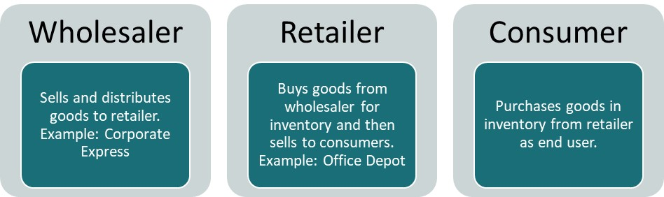
Merchandising Operations and Inventory Systems
Merchandising Companies buy and sell goods.
Examples:
Sam’s club, Walmart, Vanguard (华润万家)
The primary source of revenues is referred to as sales revenue or sales.
L O 1

Slide 89
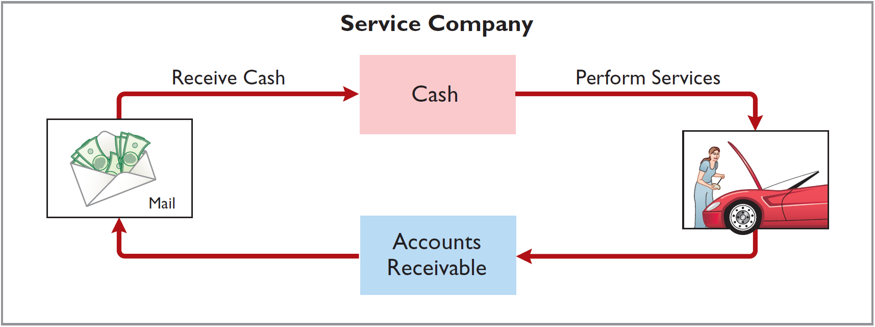
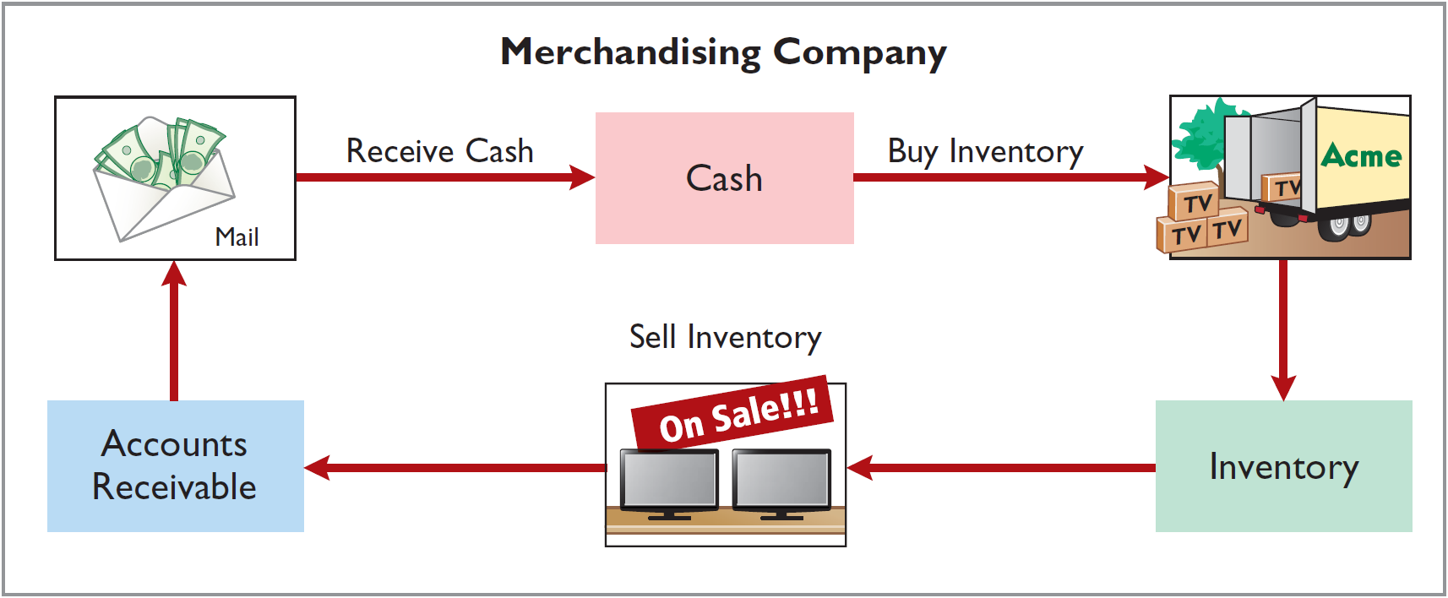
Operating Cycles
Airlines
Sam’s club
Illustration 5.2-3: Operating cycle for a service company (2) and Operating cycle for a merchandising company (3)
L O 1
Notes:
Inventory → includes items a company intends for sale (after purchase and before sold) to customers in their ordinary business operating cycle.
Inventory is a current asset because company expects to convert it into cash in the near future.

Slide 90
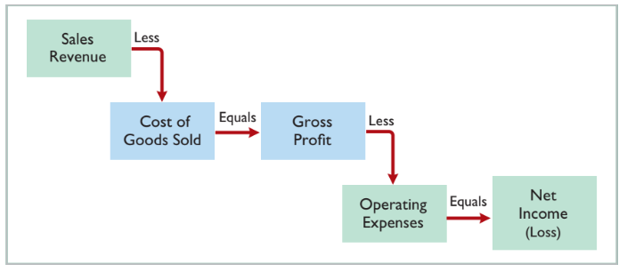
Merchandising Company
Income Measurement
Illustration 5.1: Income measurement process for a merchandising company
L O 1
Notes:
COGS: total cost of merchandise sold during the period. This is expense directly related to revenue recognized from the sale of goods.
Gross Profit = Sales Revenue – COGS. Splitting expense into two parts (1. COGS & 2. Operating Exp). Acct provide information to users. These two expenses have different purpose. COGS related to what I sold. Operating exp → how efficiently I use the resources.
Net Income = Gross Profit – Operating Expenses.

Slide 91
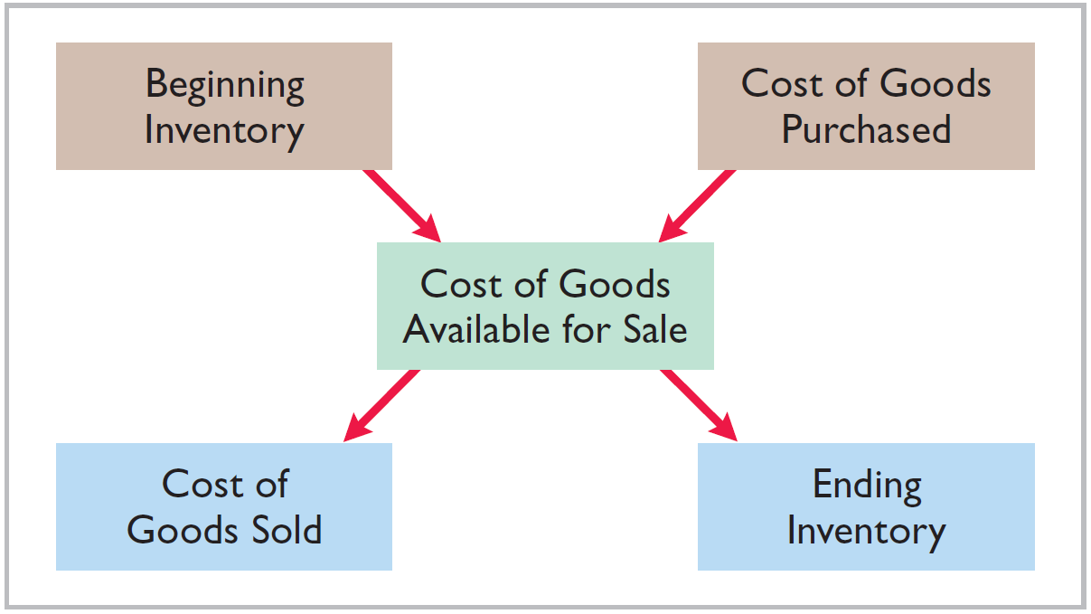
Flow of Costs Overview
Illustration 5.4: Flow of costs
Companies use either a perpetual inventory system or a periodic inventory system to account for inventory.
L O 1

